Slide 1




EEG Signal Classification
Supervised by
Sunanda Das
Assistant Professor
Department of Computer Science & Engineering
Khulna University of Engineering & Technology, Khulna
Team Members
MOHAMMAD KHAIRUL ALAM BHUIYAN
1807078
MD RISHADUL BAYESH
1807086
Department of Computer Science & Engineering
Khulna University of Engineering & Technology, Khulna.
1

Slide 2
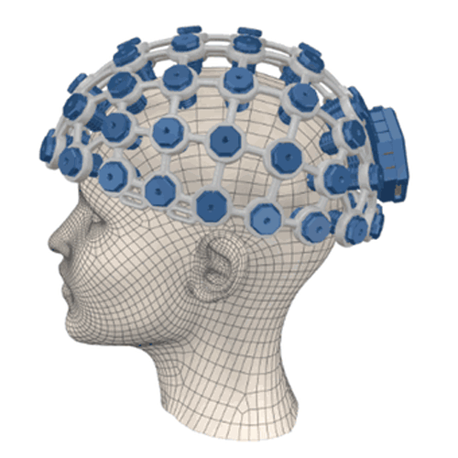
Motivation
Emotion recognition is done widely in two ways: using non-physiological signals and physiological signals
Physiological >> Non-physiological as non-physiological signals can be voluntarily obscured.
Consumer grade wearable EEG devices are becoming increasing popular. They can have multiple applications in the medical.
EEG based model emotion detection can help doctors keep track of the mental state of patient from their emotions.
2

Slide 3
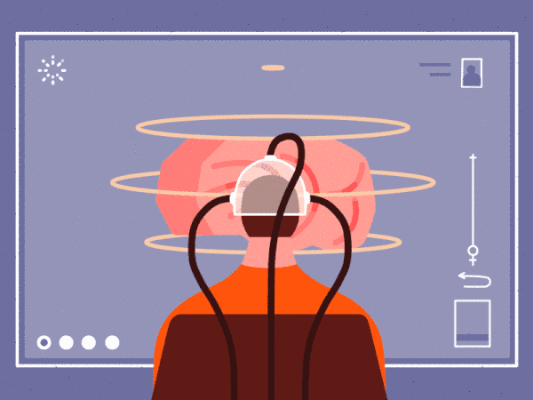
INTRODUCTIONWhat is EEG
The brain cells communicate via electrical impulses and are active all the time,even when we are asleep.
So,basically an electroencephalogram (EEG) is a machine that detects electrical activity in a human brain using small metal discs (electrodes) attached to the sleep.
This activity shows up as wavy lines on an EEG recording.
3

Slide 4
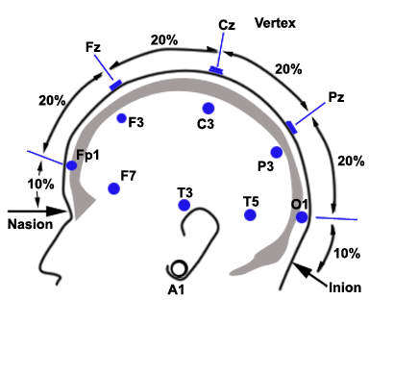
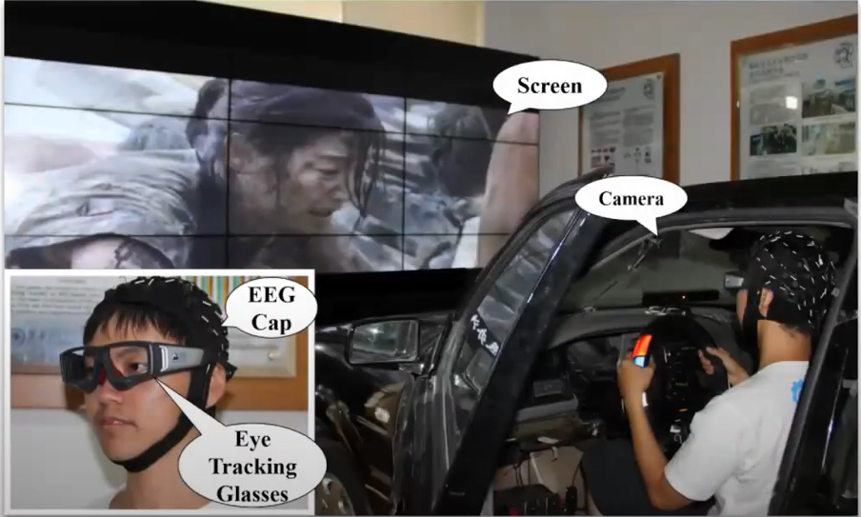
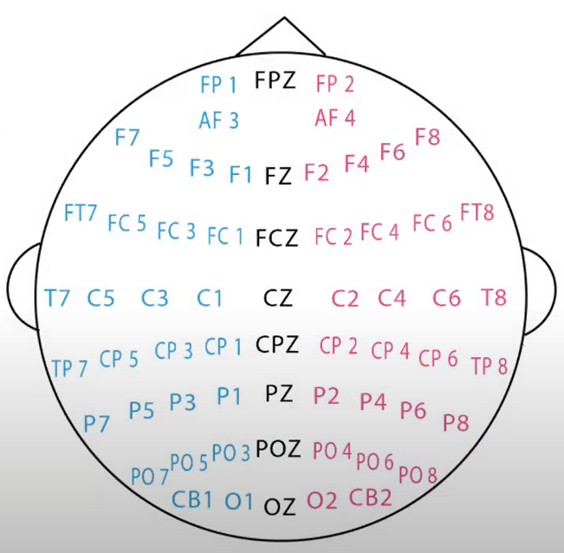
Setup – How the signals are captured
4

Slide 5
01
02
04
03
05
06
The proposition
ABOUT THE PROJECT
A system for understanding students’ behavior who are attending online classes.
A web application for online learning platforms.
PROJECT GOALS
MAIN REQUIREMENTS
Multiple Deep Learning model used for predicting students’ behavior.
A mobile device with internet connection.
PROJECT STAGES
OUR TEAM
The project goal is achieved by following a Waterflow Model
Under the supervision of Sunanda Das and the project is executed by MD. Khairul Alam Bhuiyan and MD. Rishadul Bayesh
5

Slide 6
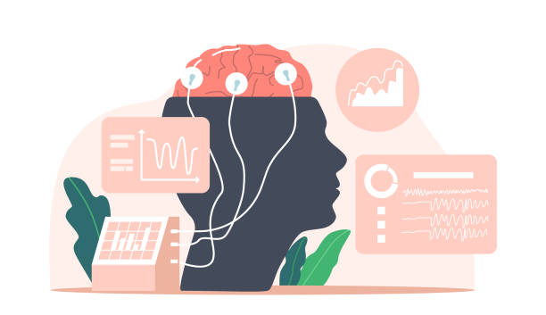
The proposition
Online learning platform is getting very popular day by day.
People are more interested in learning through online rather than attending classes physically.
The creators are creating educational videos daily.
But the creators don’t know whether the videos which, they are providing are understood by the people or not.
Having a system like this, is quite beneficial to the creators
6

Slide 7
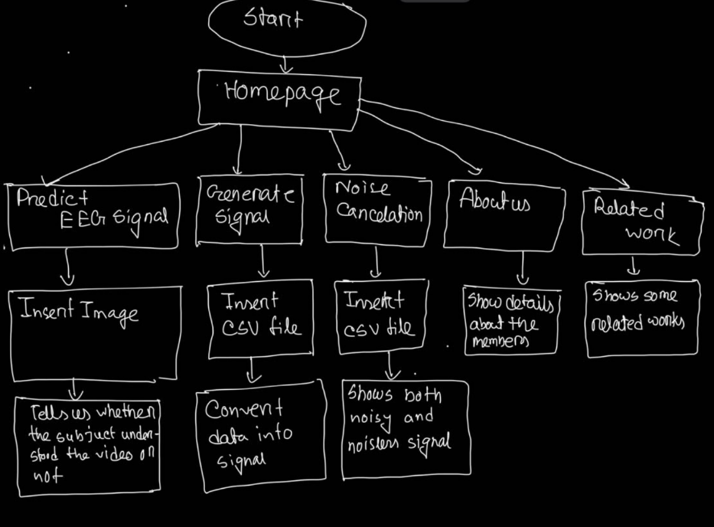
Architecture Style
7

Slide 8
ABOUT THE PROJECT
For solving the issues discussed previously a web application has been created that can perform the all the features.
8

Slide 9
A WEB application
Overview
9

Slide 10
features
Here is the list of the features which have been implemented in the application.
From predict EEG signal option, the system will tell the prediction.
From generate signal option, the system will convert the csv file into signals.
From noise cancelation option, it will show both the nosiy signal as well as the noiseless signal.
From about us option , it will show the members who are working on this system.
10

Slide 11
Technical features
Technical requirement and features of the application.
Must give the permission to access the storage .
Must have a screen to see the results.
Must have network connectivity.
Have a minimum storage of 50 MB of that device
Must have the internet connection to use the features of the application
11

Slide 12
UI Design
Graphical Design of the Implemented Application
12

Slide 13
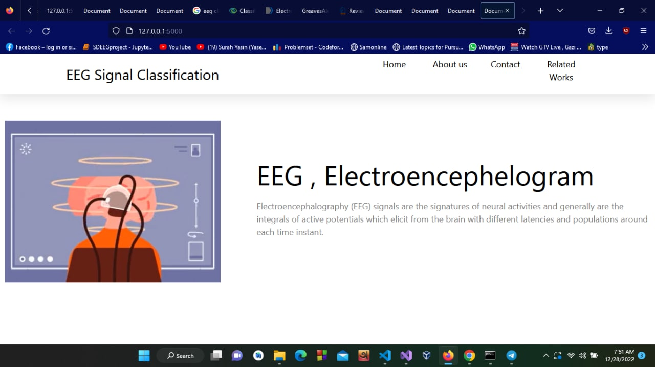
Graphical User Interface
Fig1.1: Homepage
13

Slide 14
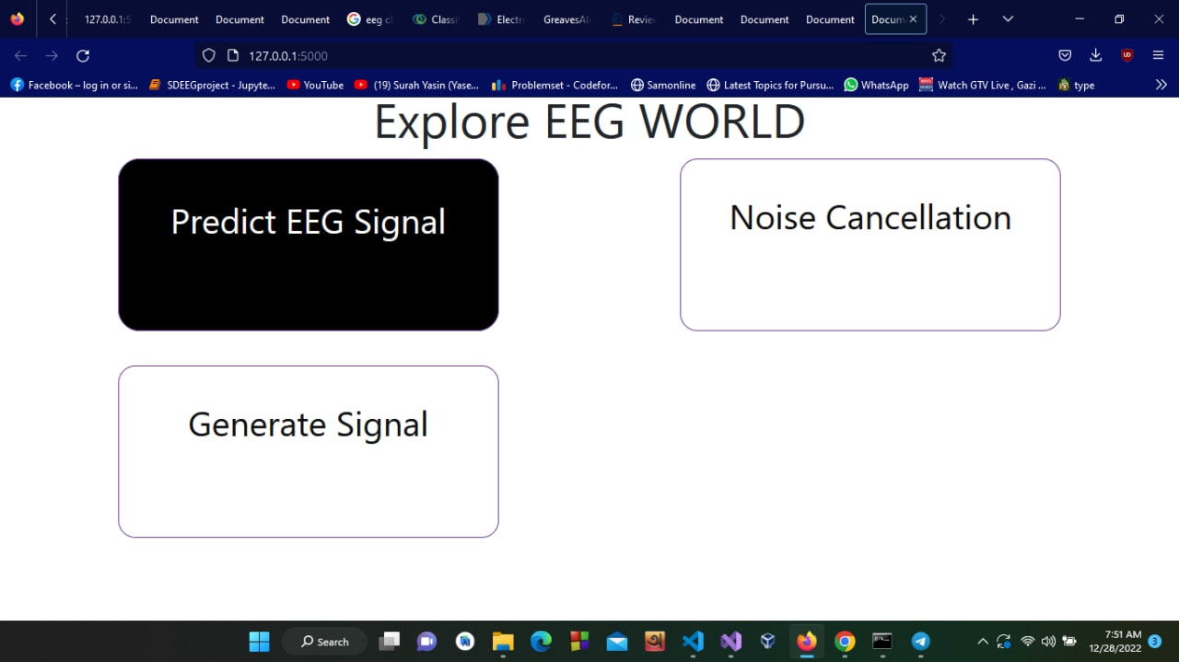
Graphical User Interface
Fig 1.2: Homepage 2
14

Slide 15
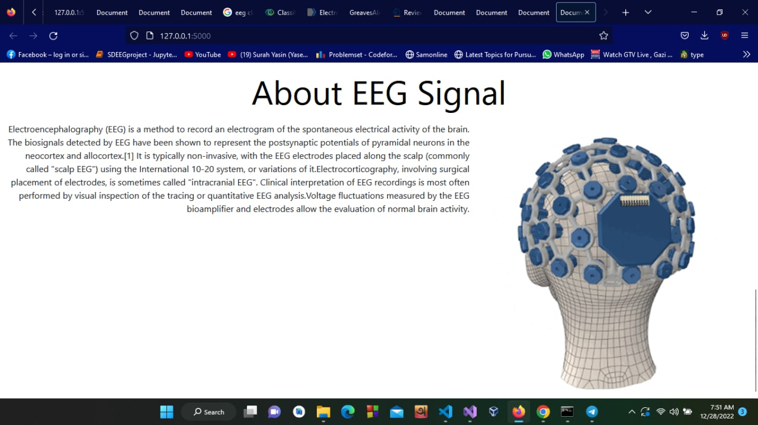
Graphical User Interface
Fig 1.3 : Homepage 3
15

Slide 16
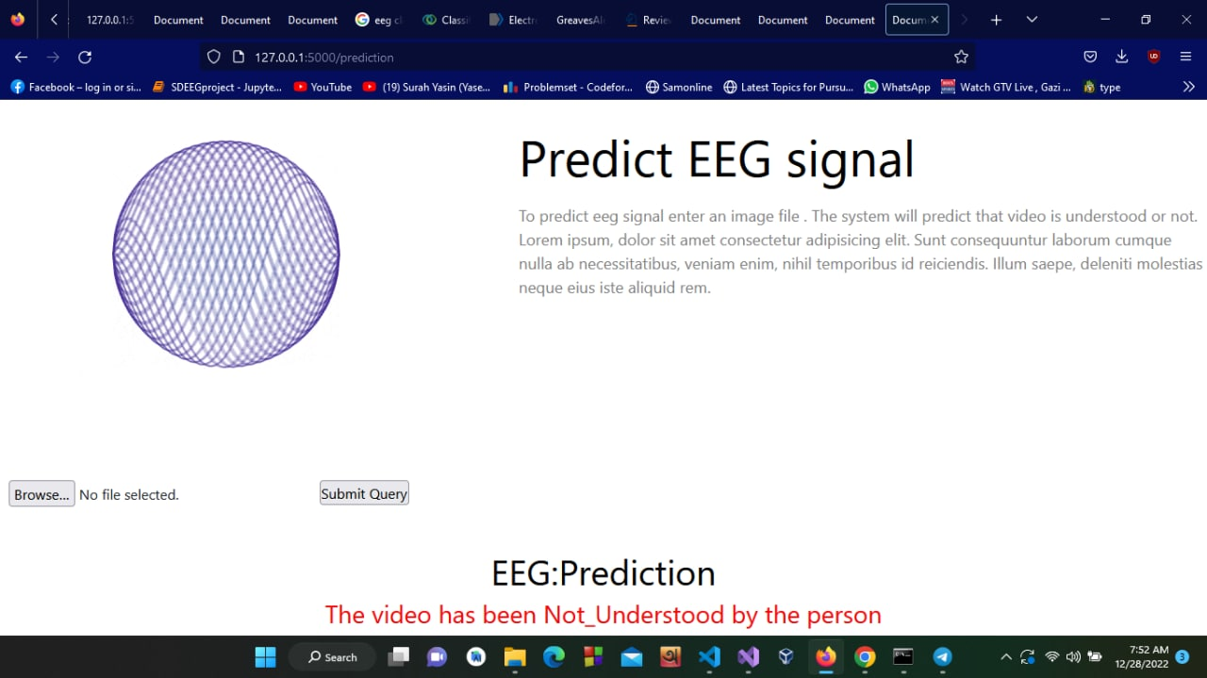
Graphical User Interface
Fig 1.4 : Predicting signal using a image
16

Slide 17
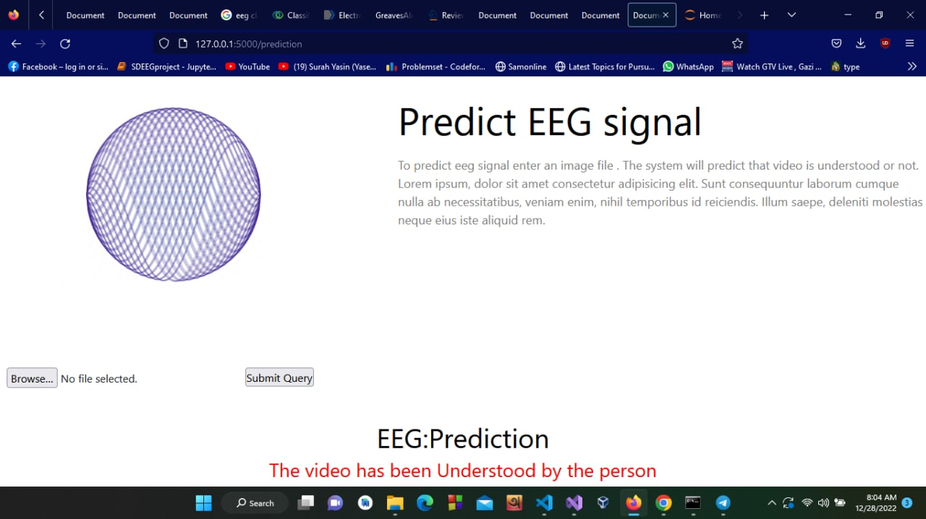
Graphical User Interface
Fig 1.4 : Predicting signal using a image
17

Slide 18
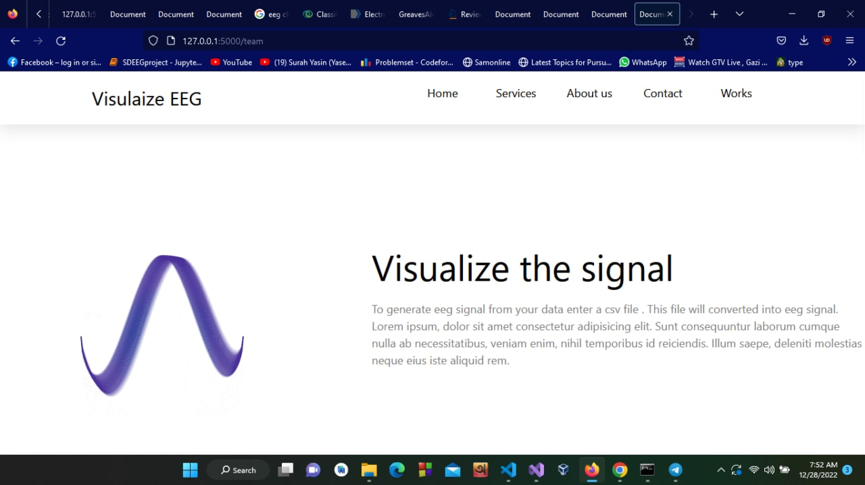
Graphical User Interface
Fig 1.4 : Visualization of the signals page
18

Slide 19
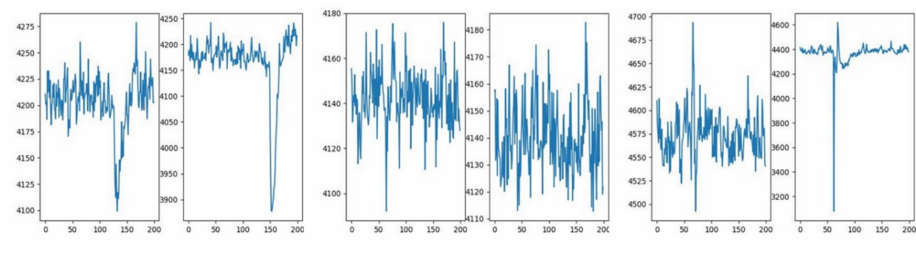
Graphical User Interface
Fig 1.5 : Left(noisy) and right (noiseless) signal
19

Slide 20
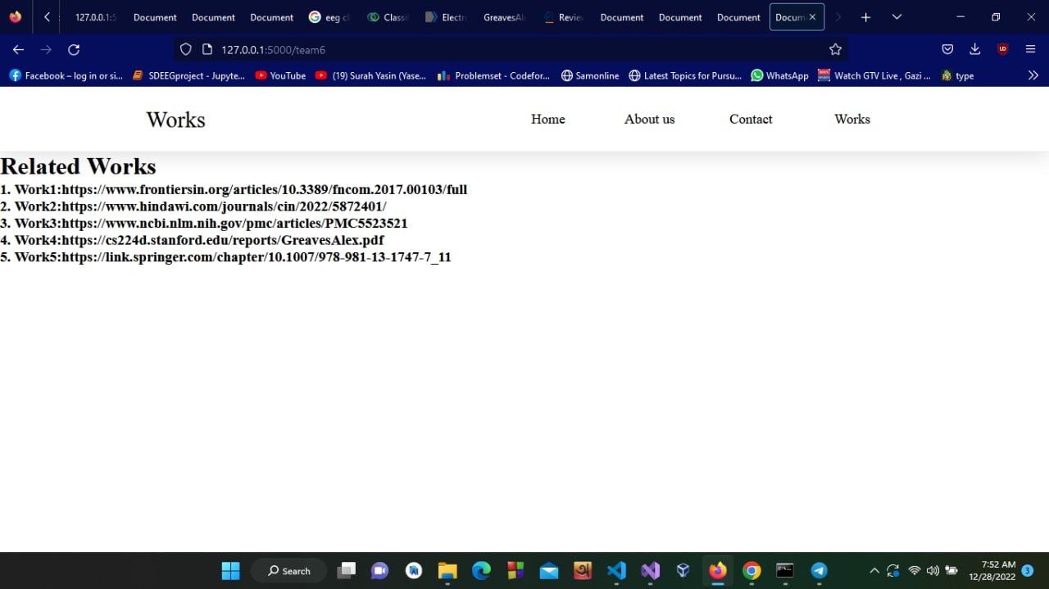
Graphical User Interface
Fig 1.6 : Related Works
20

Slide 21

Graphical User Interface
Fig 1.7: Details about the members
21

Slide 22
Back-End features
Summary
22

Slide 23
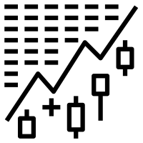
Dataset
Contains 17 columns.
Columns 1-2 contains video id and subject id.
Columns 3-16 contains raw EEG data from 14 sensors.
Column 17 contains binary variable of understanding.
23

Slide 24

Dataset preprocessing
Selected the shortest video length.
Make others to that same length
24

Slide 25
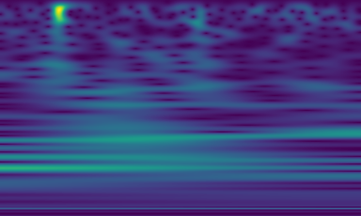
Image generate
Convert the csv file to MNE format.
Convert the data into scaliogram.
Then convert the signals to images using squeeze pi.
Fig: Image of a signal
25

Slide 26
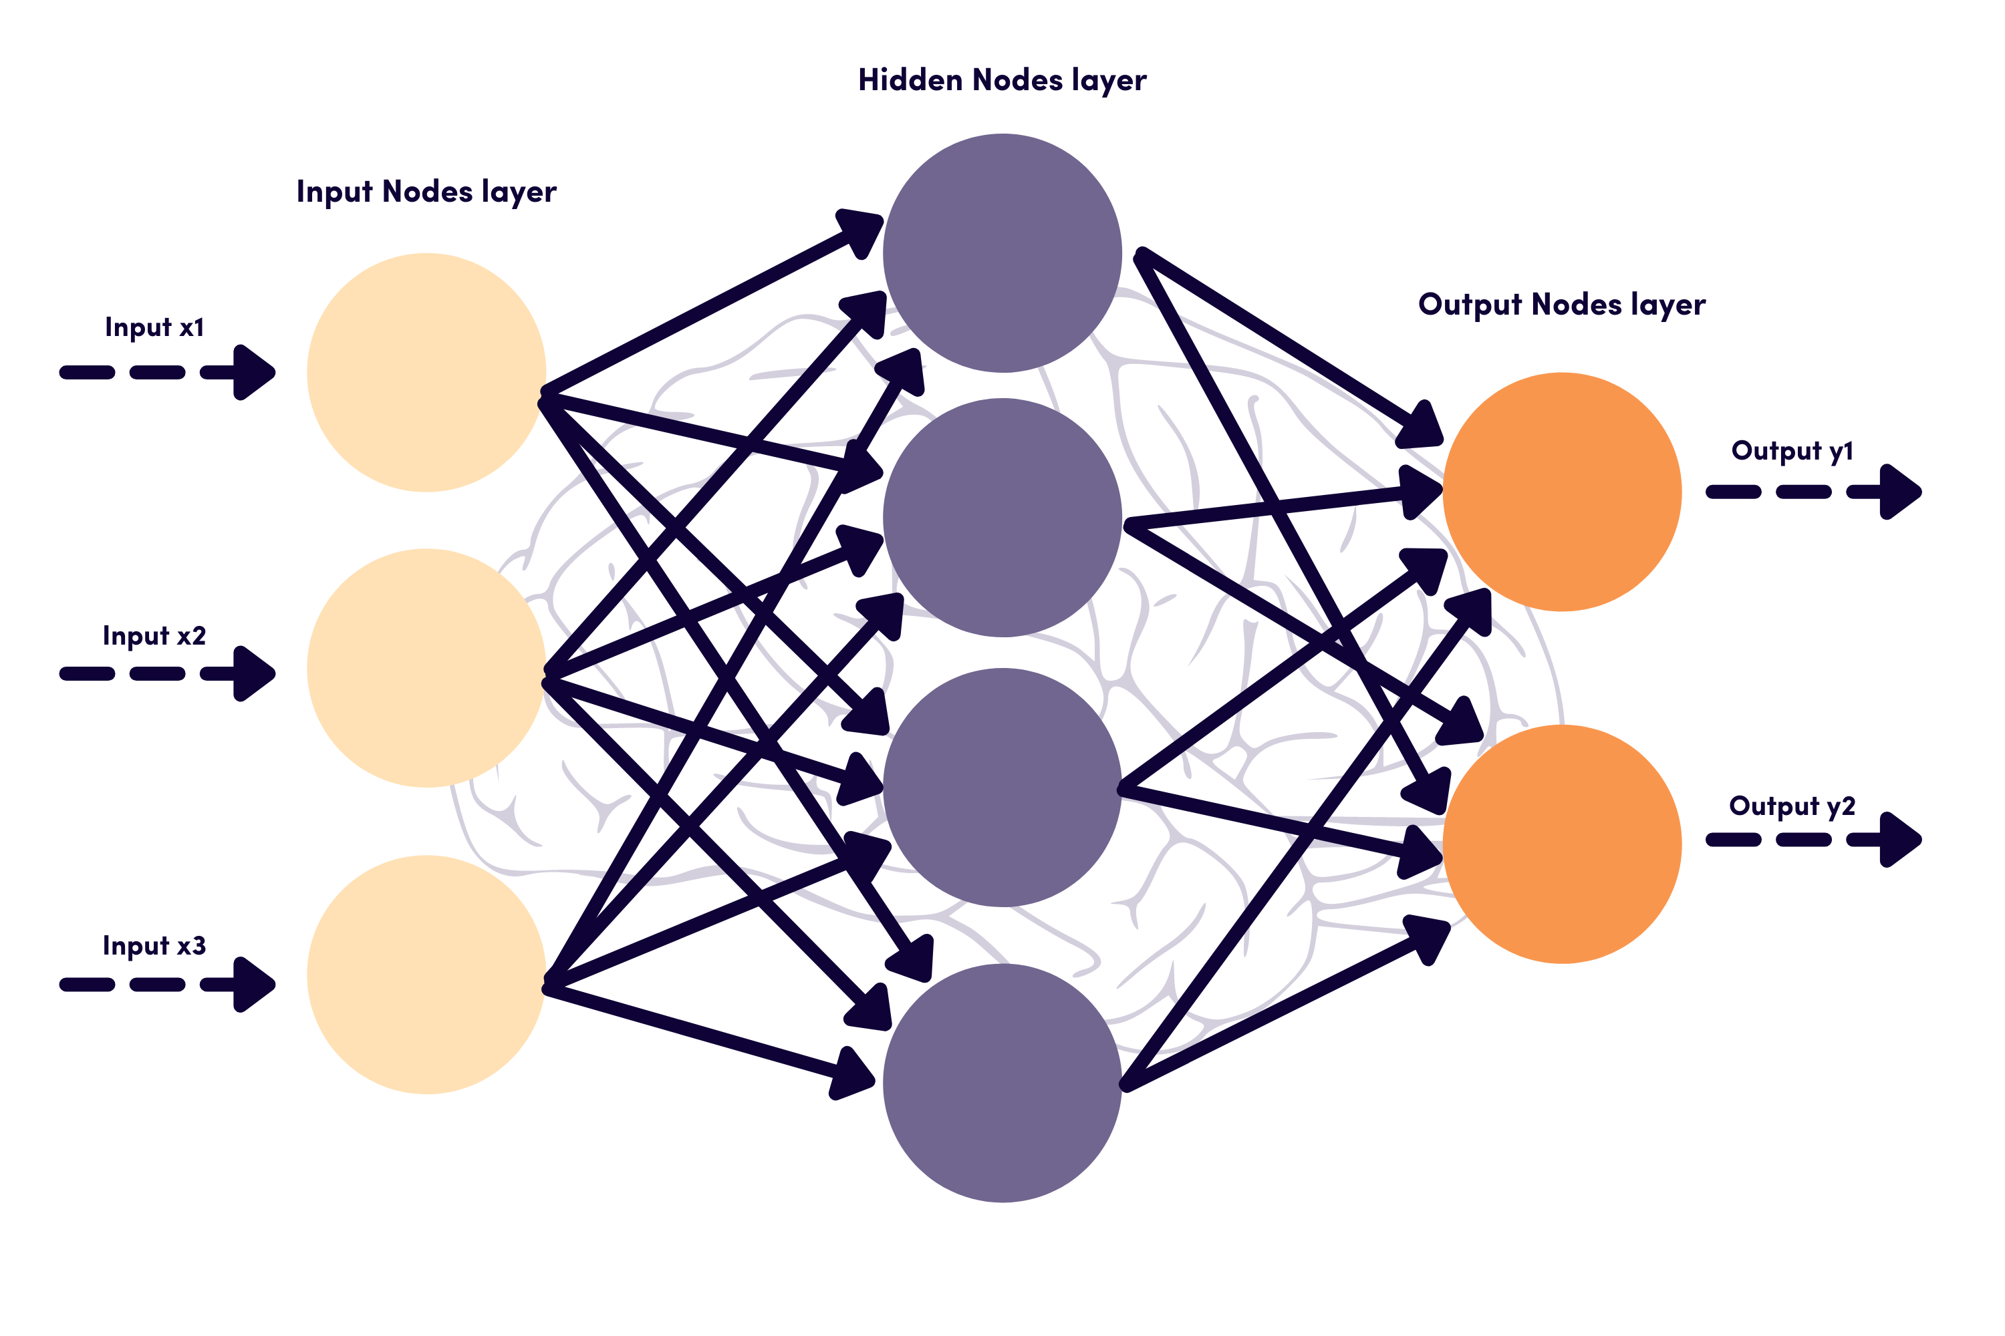
A CNN Sequential Model has been integrated for the prediction .
26

Slide 27
Project Management
Project management plan
27

Slide 28
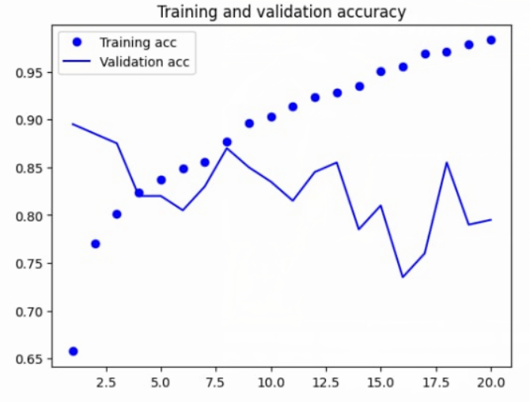
The predict test
28

Slide 29
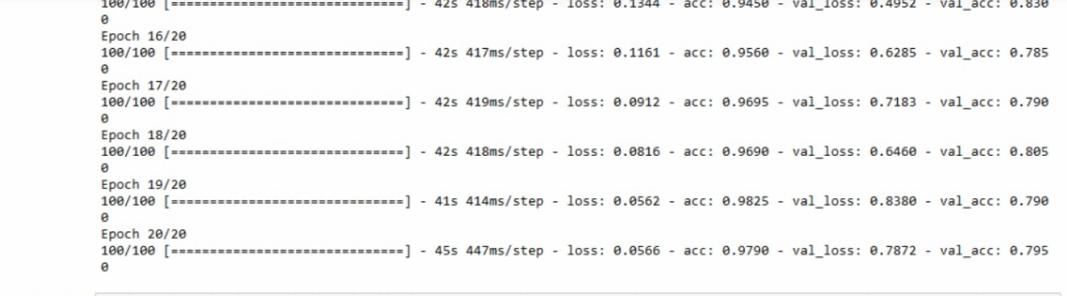
The Predict Test
29

Slide 30
Lifecycle Model Used
To achieve the goals and a successful implementation of the program a water flow model has been used.
The sequential phases in Waterfall model are
Requirement Gathering and analysis
System Design
Implementation
Integration and Testing
Deployment of system
Maintenance
30

Slide 31
Observing the requirement traceability we can see all the requirements to check if the requirements have been fulfilled
All initial requirements fulfilled
31

Slide 32
References
Here is the list of the things which have been used when making the project,
Li, Ren, Jared S. Johansen, Hamad Ahmed, Thomas V. Ilyevsky, Ronnie B. Wilbur, Hari M. Bharadwaj, and Jeffrey Mark Siskind. "The perils and pitfalls of block design for EEG classification experiments." IEEE Transactions on Pattern Analysis and Machine Intelligence 43, no. 1 (2020): 316-333.
Al-Saegh, Ali, Shefa A. Dawwd, and Jassim M. Abdul-Jabbar. "Deep learning for motor imagery EEG-based classification: A review." Biomedical Signal Processing and Control 63 (2021): 102172.
Dai, Mengxi, Dezhi Zheng, Rui Na, Shuai Wang, and Shuailei Zhang. "EEG classification of motor imagery using a novel deep learning framework." Sensors 19, no. 3 (2019): 551.
Mao, W. L., H. I. K. Fathurrahman, Y. Lee, and T. W. Chang. "EEG dataset classification using CNN method." In Journal of physics: conference series, vol. 1456, no. 1, p. 012017. IOP Publishing, 2020.
Wang, Xiao-Wei, Dan Nie, and Bao-Liang Lu. "Emotional state classification from EEG data using machine learning approach." Neurocomputing 129 (2014): 94-106.
An, Xiu, Deping Kuang, Xiaojiao Guo, Yilu Zhao, and Lianghua He. "A deep learning method for classification of EEG data based on motor imagery." In International Conference on Intelligent Computing, pp. 203-210. Springer, Cham, 2014.
https://keras.io/guides/sequential_model
https://www.kaggle.com/datasets/
https://www.youtube.com/
32

Slide 33

THANKS for your Attention
Does anyone have any thoughts?
33

